Slide 1
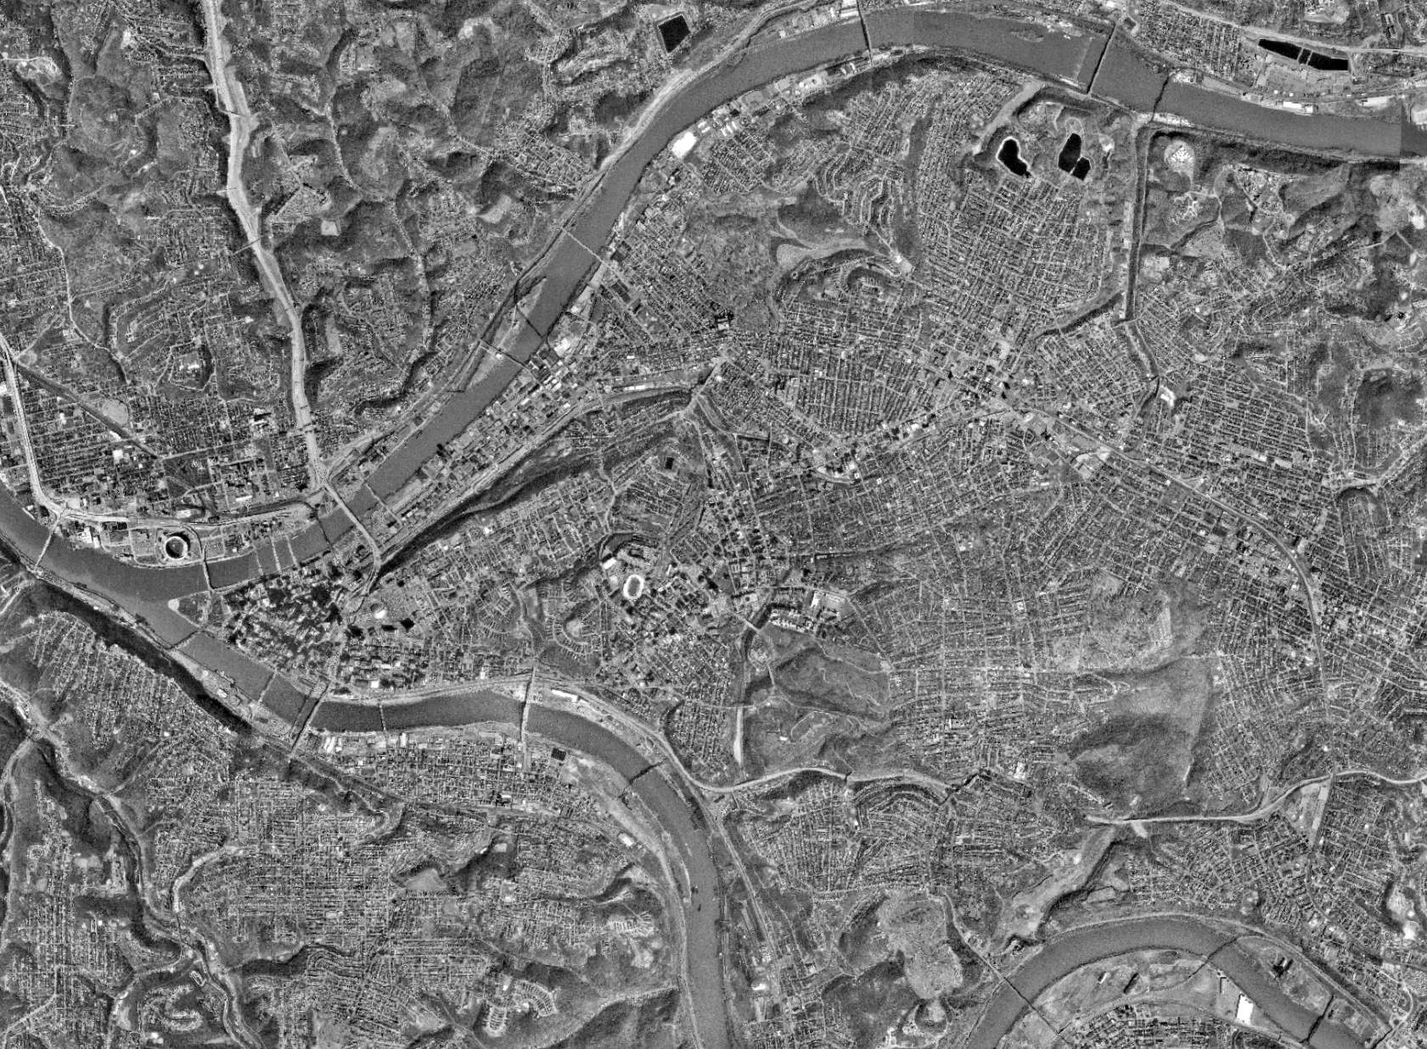

GIS/
CAFM
48569// ASSIGNMENT 02
FACULTY: PROF. KRISTEN KURLAND
TEACHING ASSISTANT’S: SANAZ SAADATIFAR + MORGAN NEWMAN + SEAN XU
SACHIN
DABAS, MSSD, SOA

Slide 2
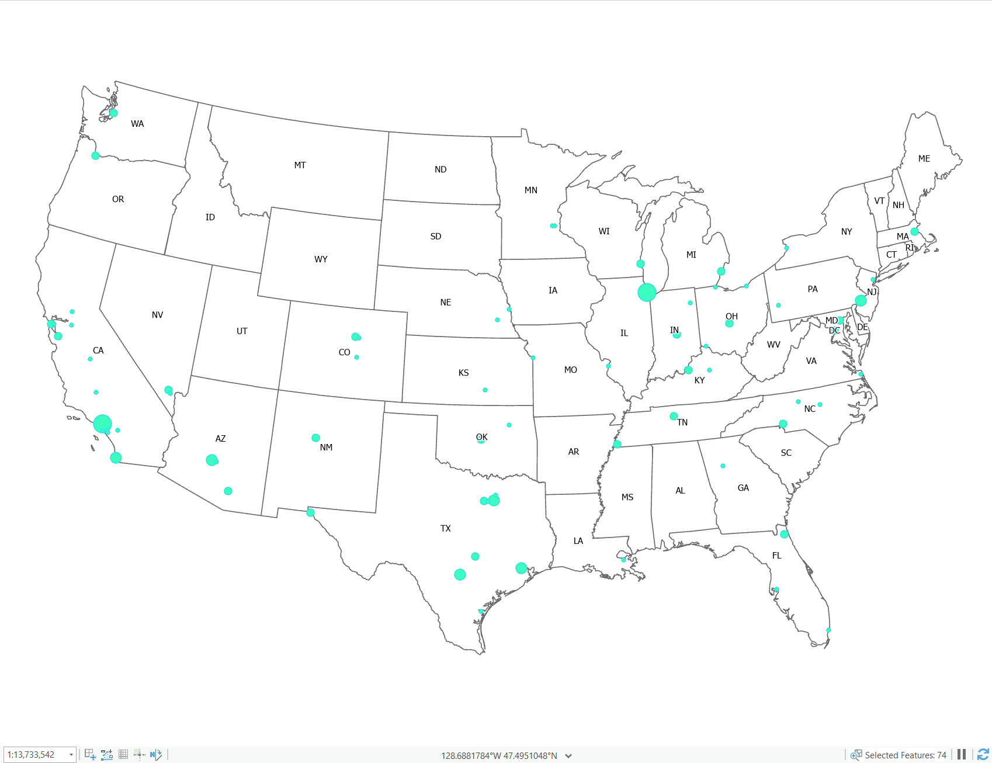
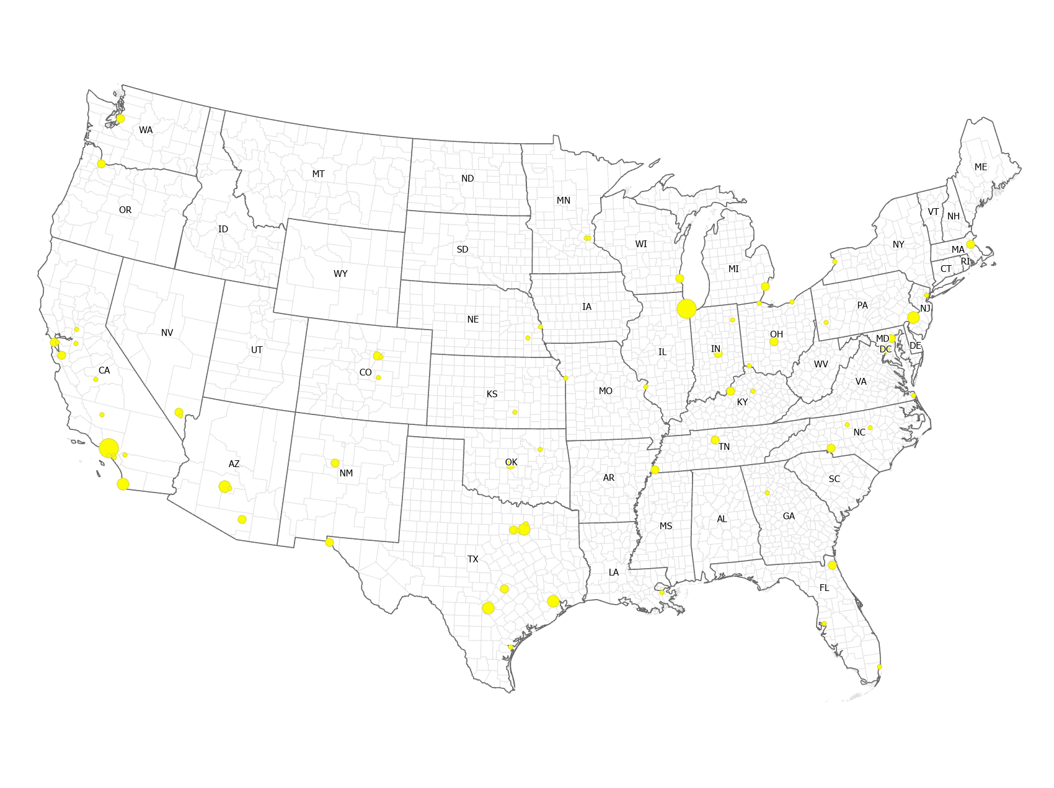
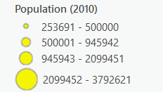
48569// US Major Cities + Increased Population

Slide 3
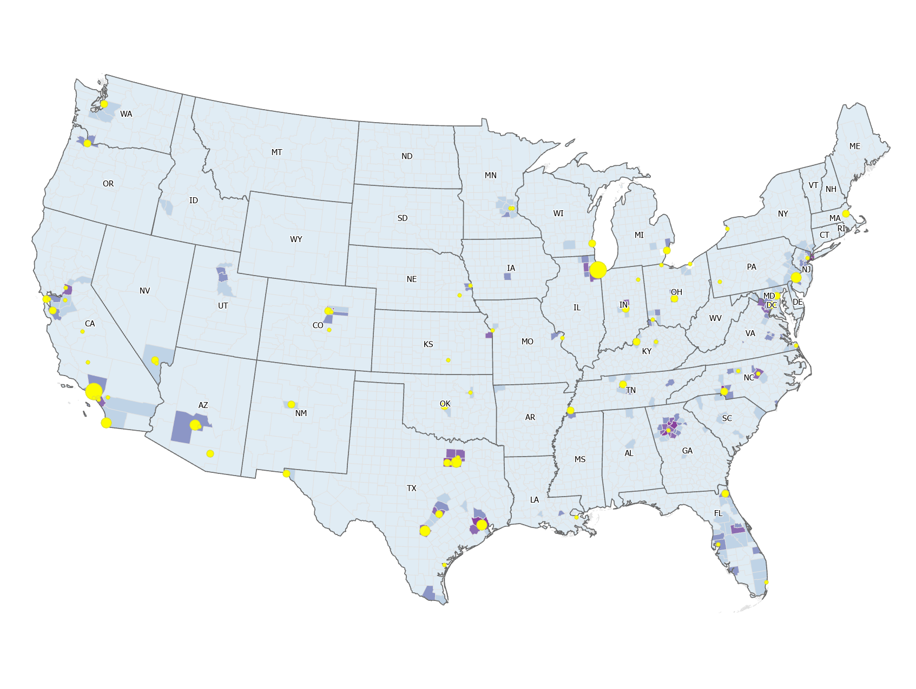
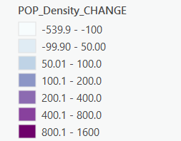
48569// US Major Cities + Counties + Population Density Change

Slide 4
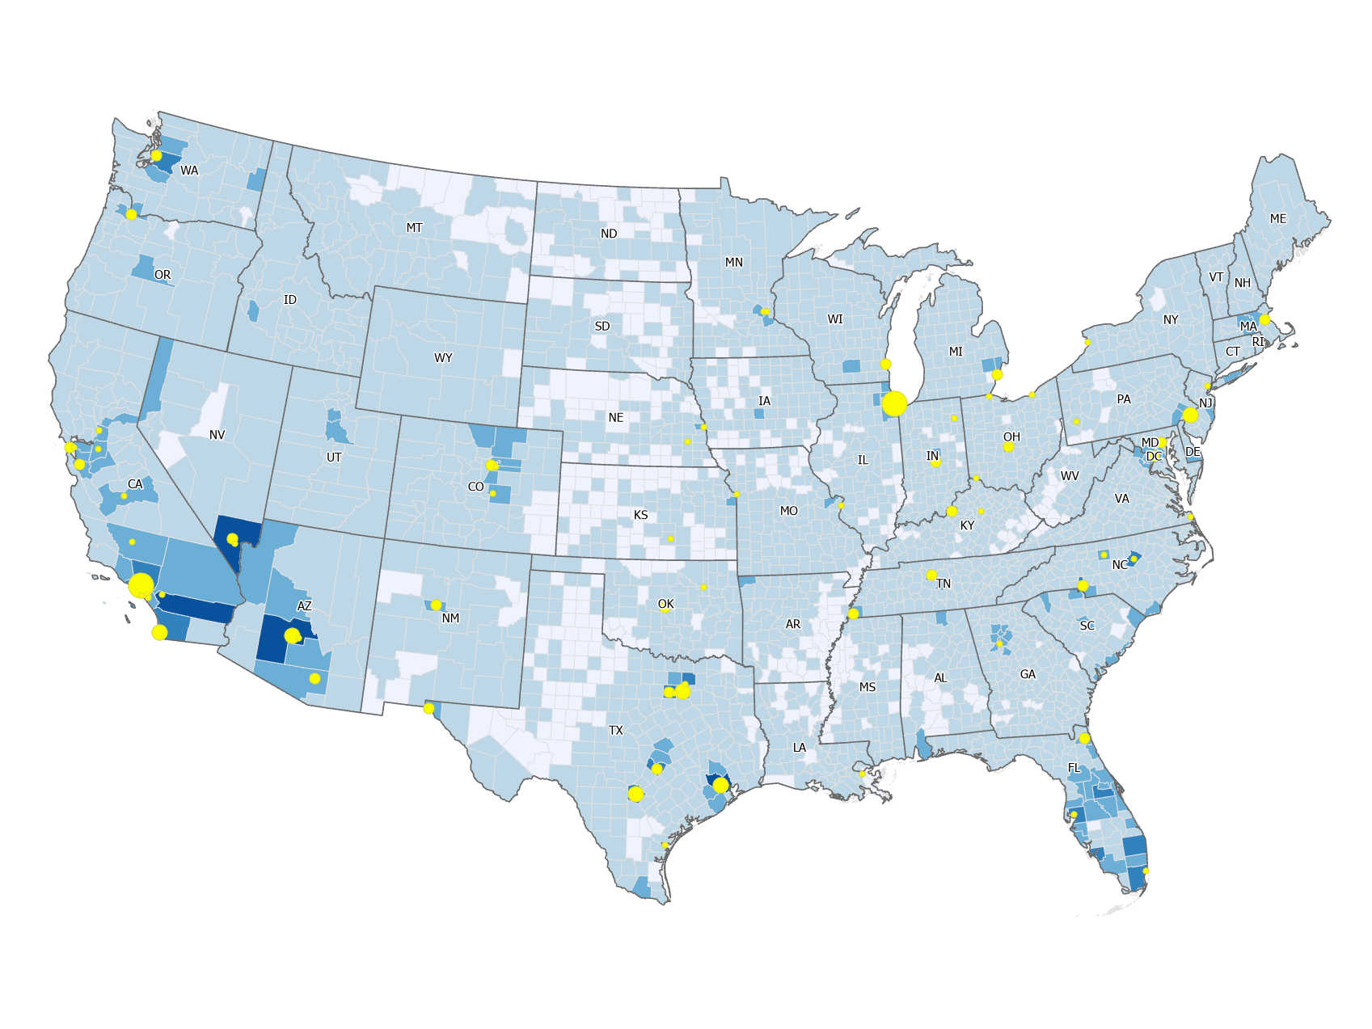
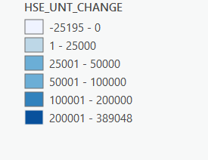
48569// US Major Cities + Counties + Housing Density Change

Slide 5
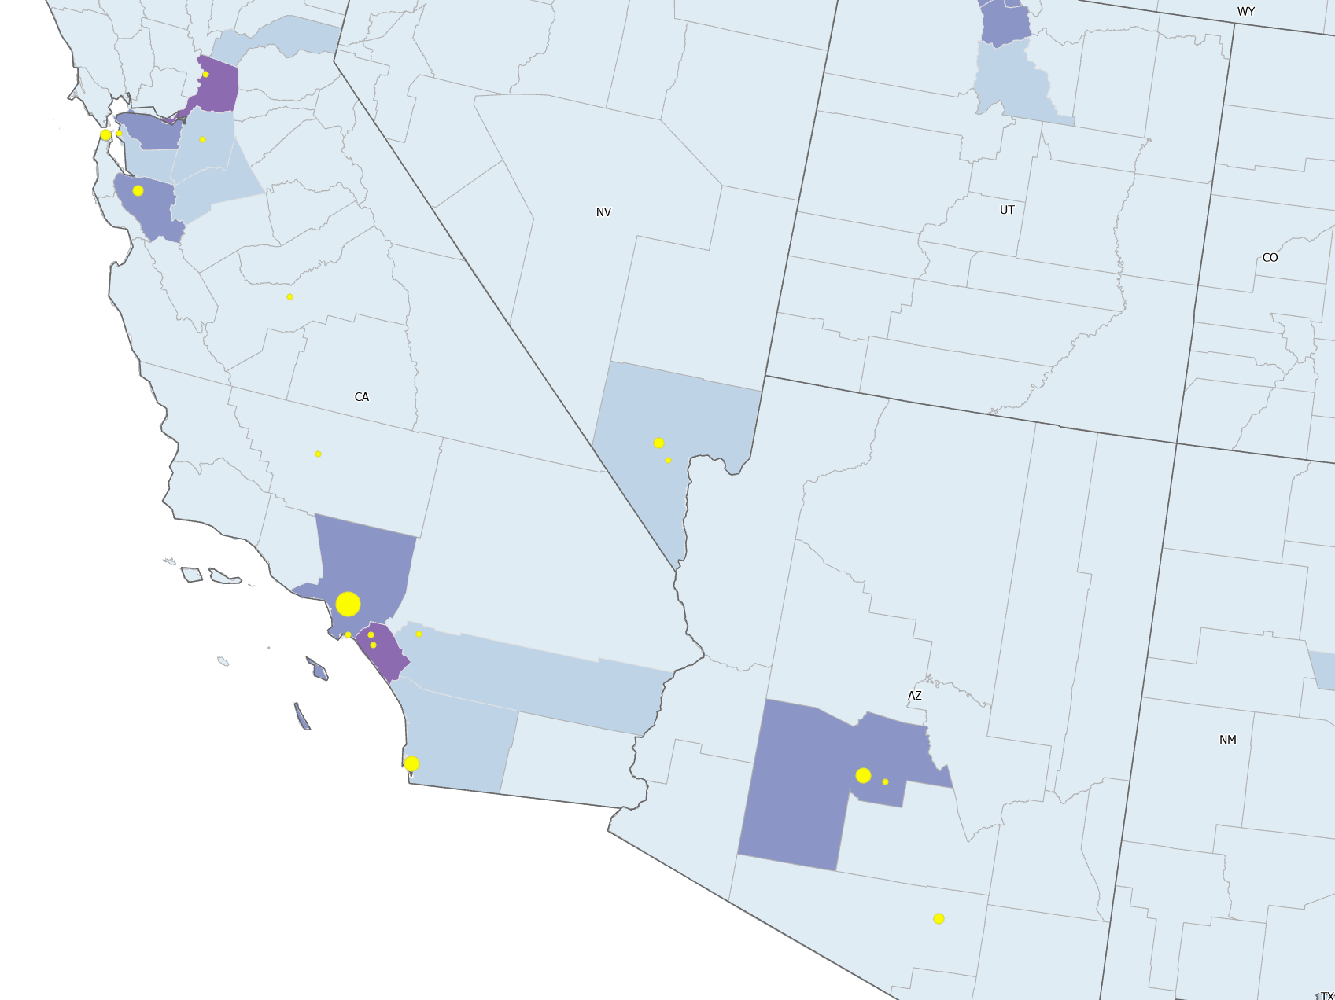
48569// California - Population Density Map + Population

Slide 6
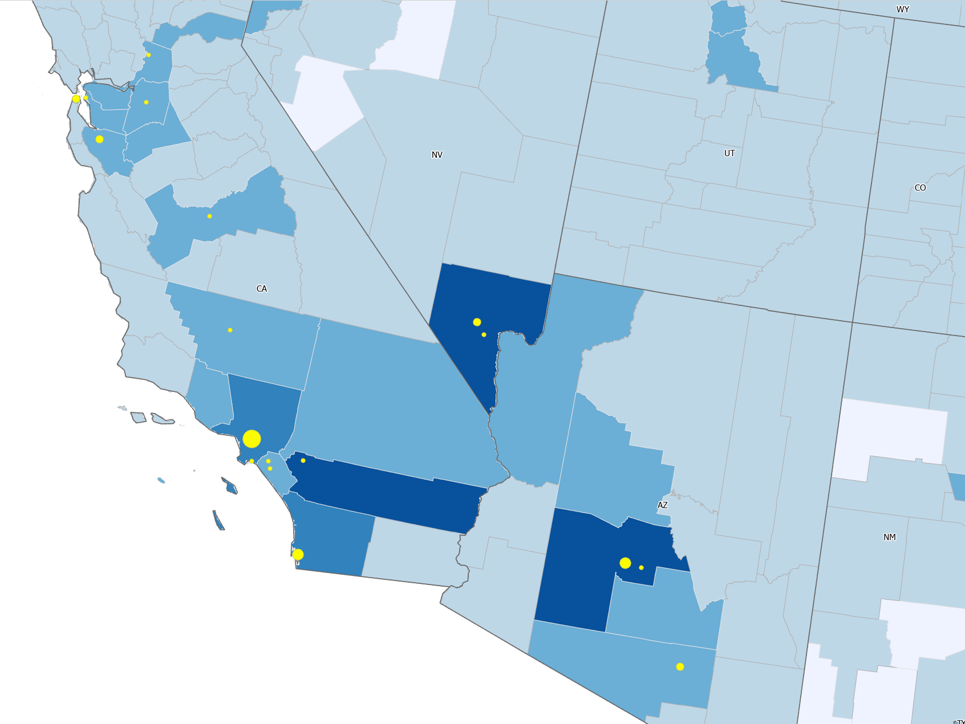
48569// California - Housing Density Map + Population

Slide 7
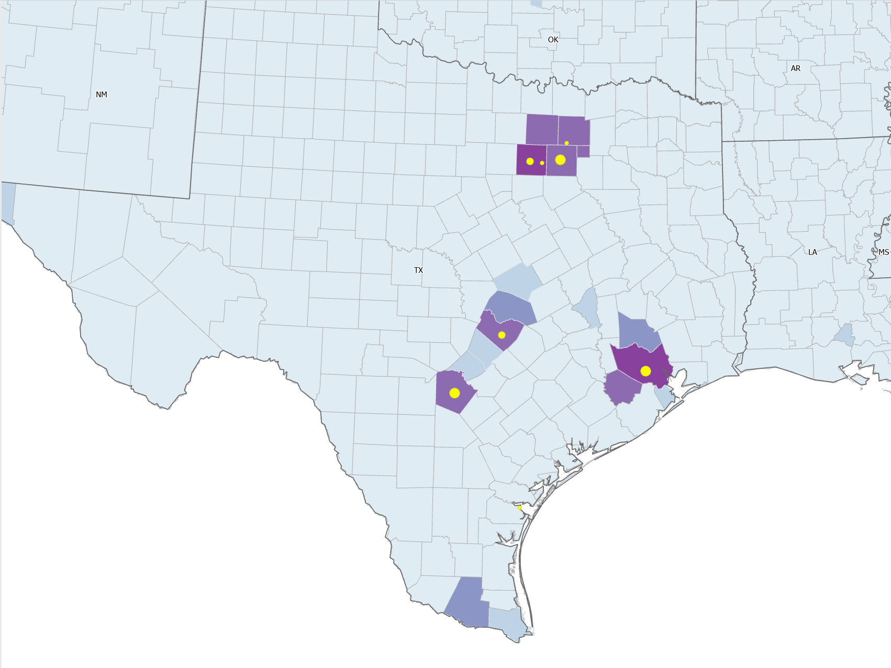
48569// Texas - Population Density Map + Population

Slide 8
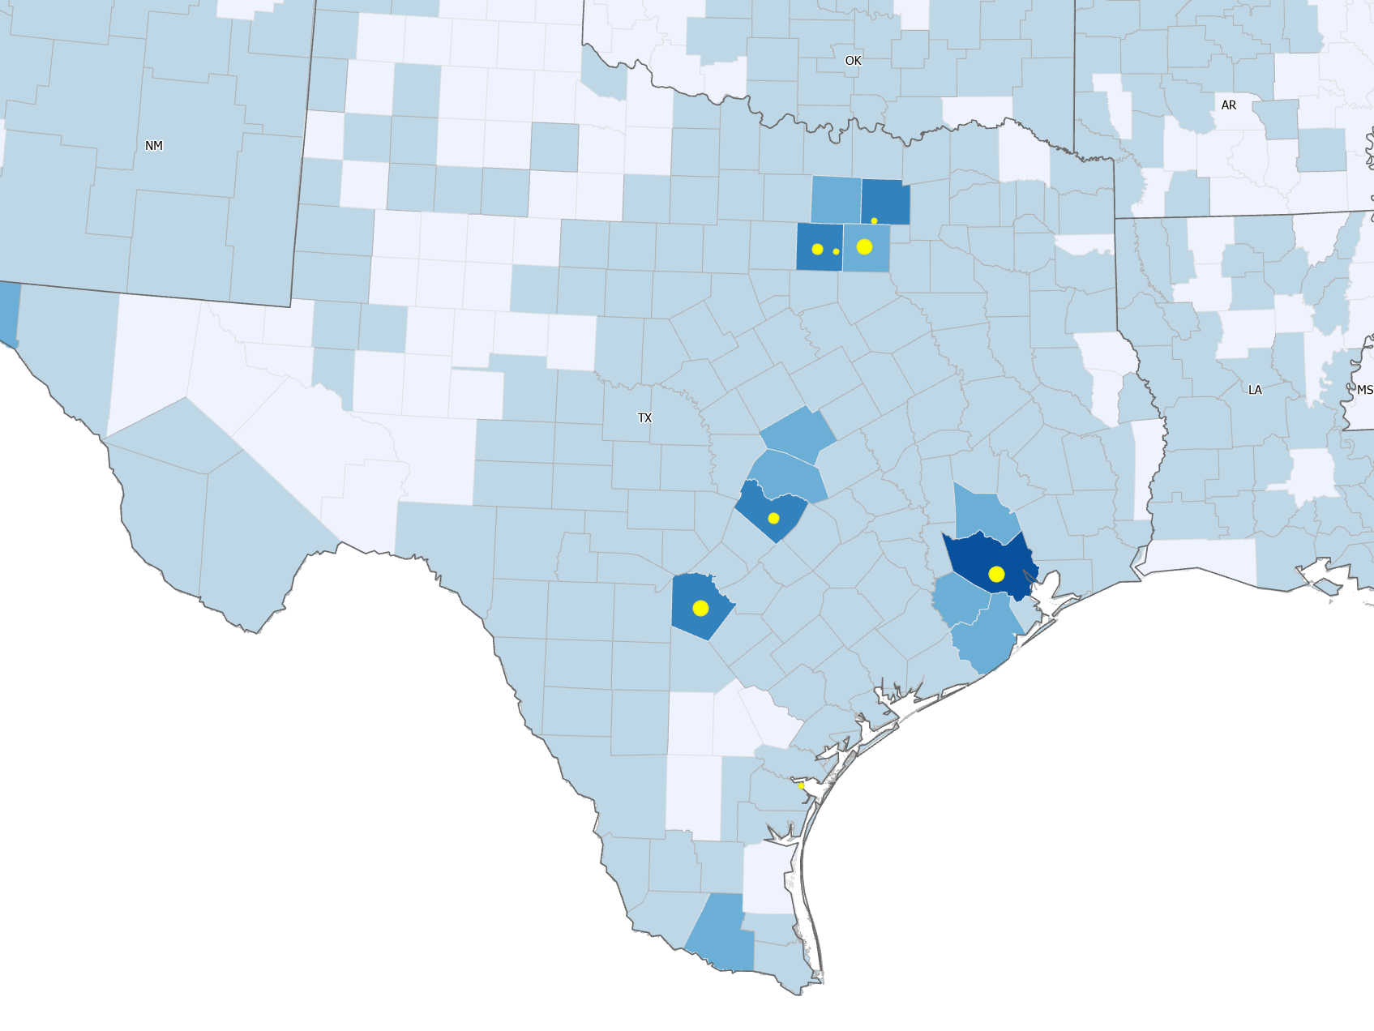
48569// Texas - Housing Density Map + Population

Slide 9

The data collected from the ArcGIS is an important factor as Population and Housing numbers are often indicators of economic health and sustainability. Planners study these data to determine what modifications economic development should occur in a state, county, city, or neighborhood. In this assignment Icreated maps of the US showing the changes in population and housing. The US Census Bureau has not yet released the 2020 decennial data.
THANKS
Work produced in ArcGIS Pro

